Slide 1

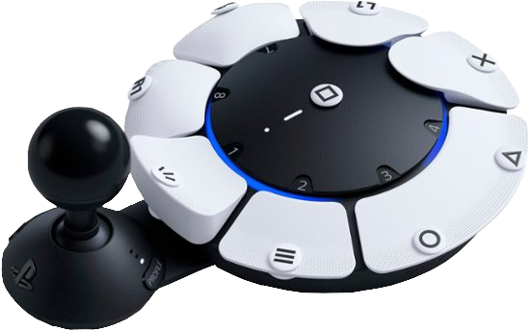
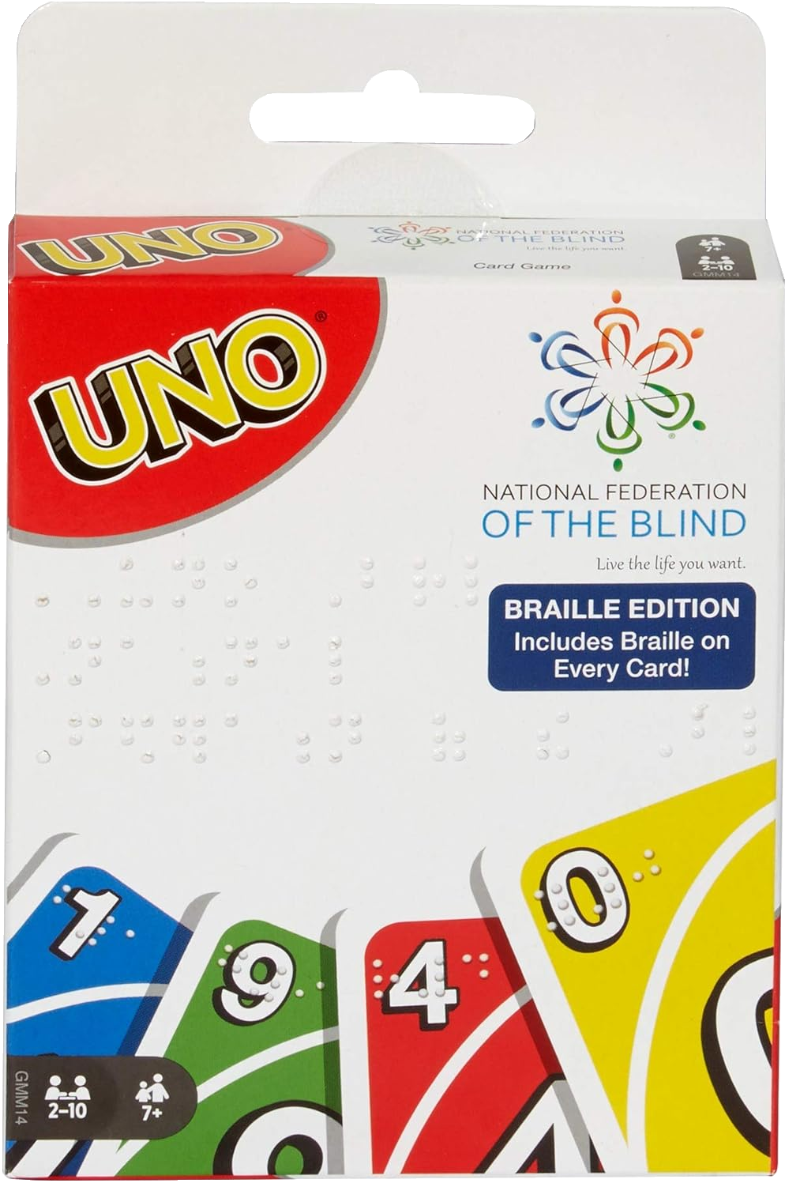

From Keyboards to Dice
Accessibility in All Gaming Experiences

Slide 2

When everybody plays, we all win.
Notes:
I sourced the Microsoft “When everybody plays, we all win” video from the following YouTube page: https://www.youtube.com/watch?v=CncTUQgRr8k

Slide 3
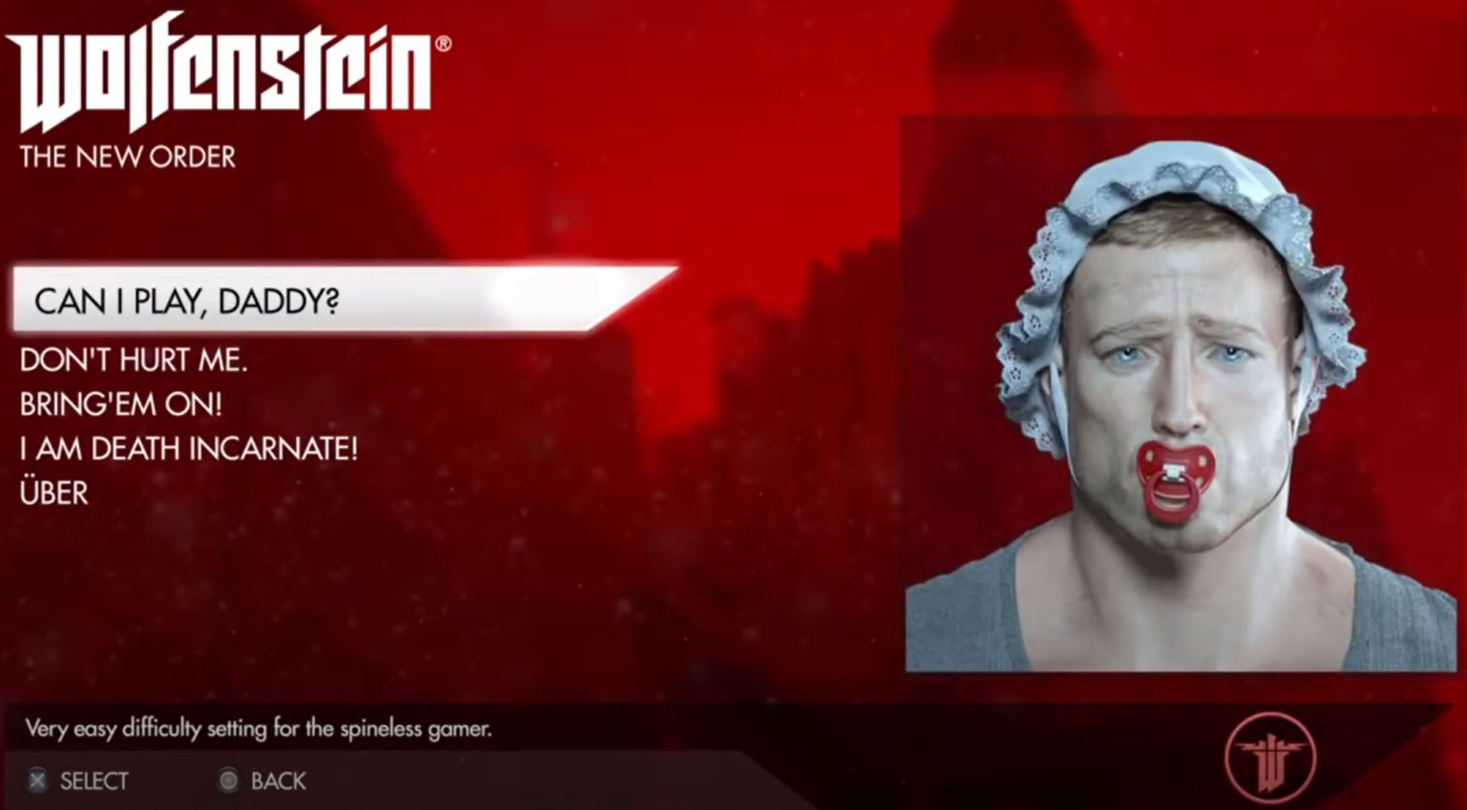
Myths
It is expensive
It takes away the challenge

Slide 4
Ways to make things accessible
Control Mapping | Subtitles & Captions | Tactile buttons / stickers | Sticky keys | Turning off flashing
Icons / Symbols | Audio cues | Alternative controllers | Alternate Game Modes | Slowing animations
High contrast mode | Color adjustments | Larger pieces | Difficulty modes | Misophonia mode
Arachnophobia mode | Brightness & Contrast Adjustment | Audio Descriptions | Quest indicators | Quest Log

Slide 5
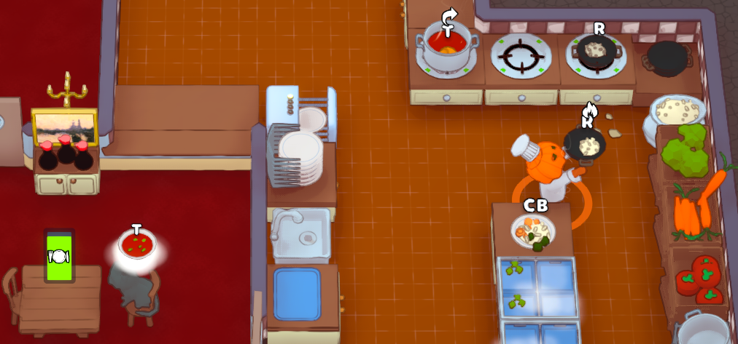
Accessibility Benefits All

Slide 6
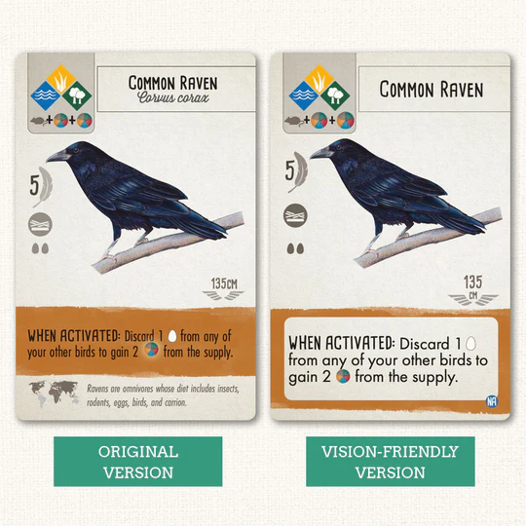
Wingspan Visually Friendly Cards

Slide 7
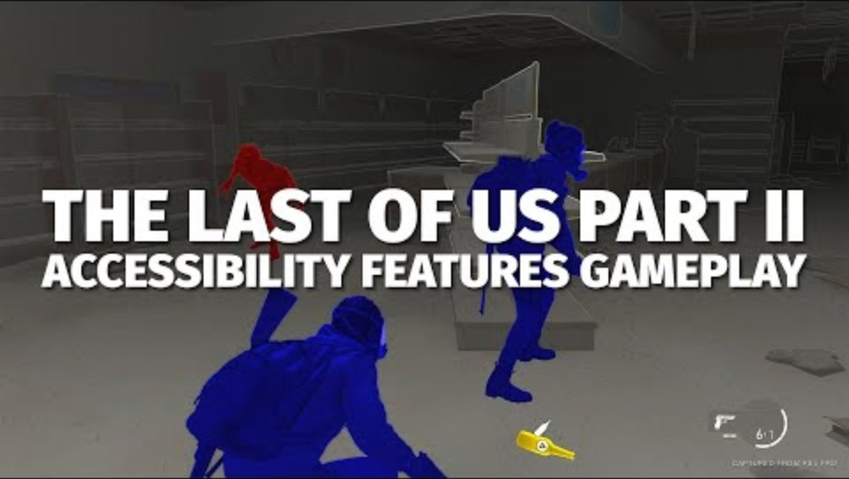

Last of Us Examples

Slide 8
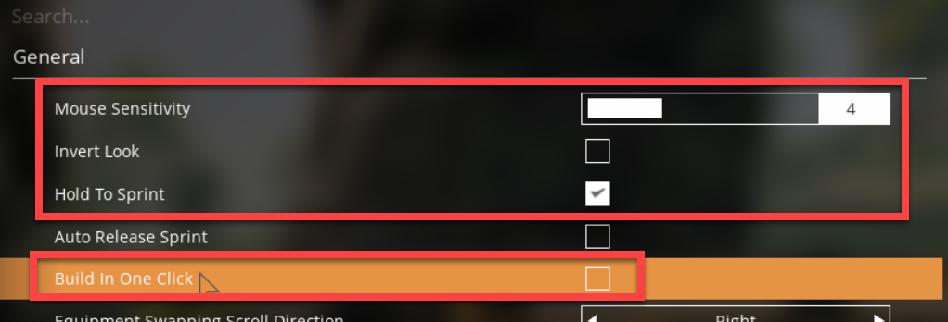
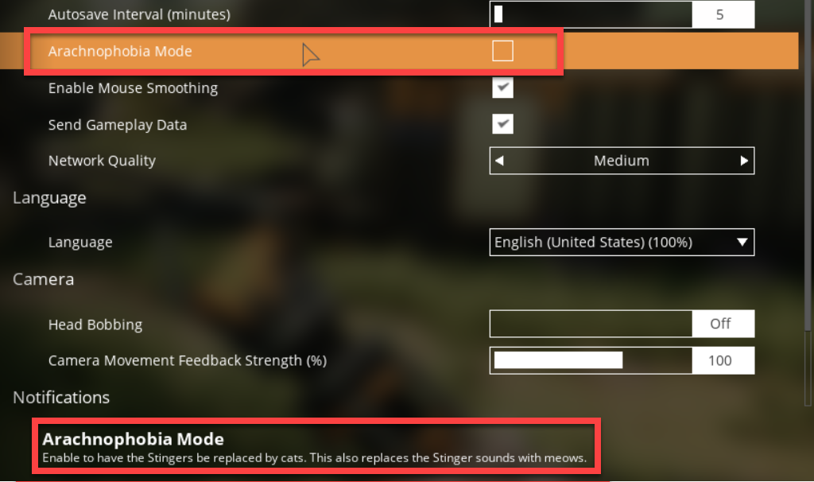
Satisfactory Examples

Slide 9
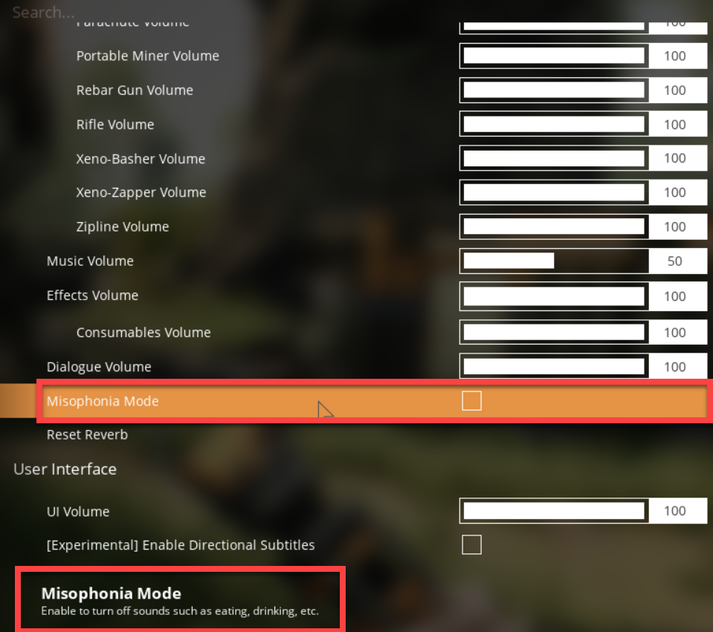
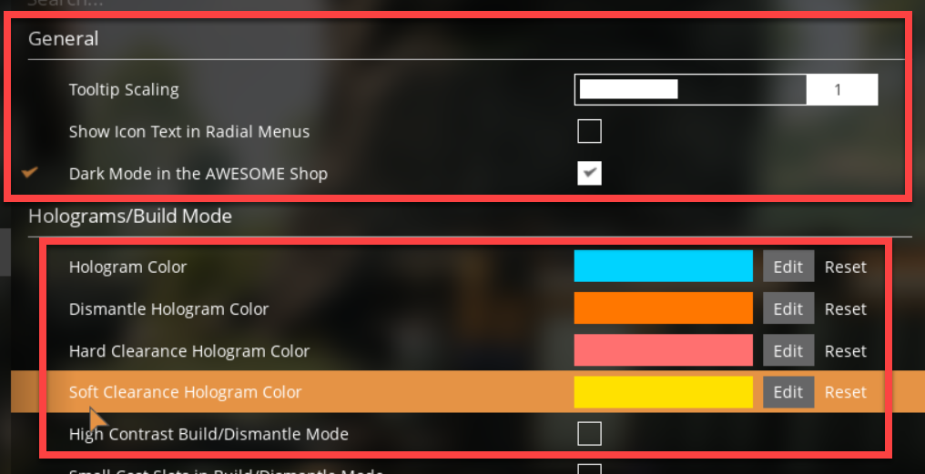
Satisfactory Examples #2

Slide 10
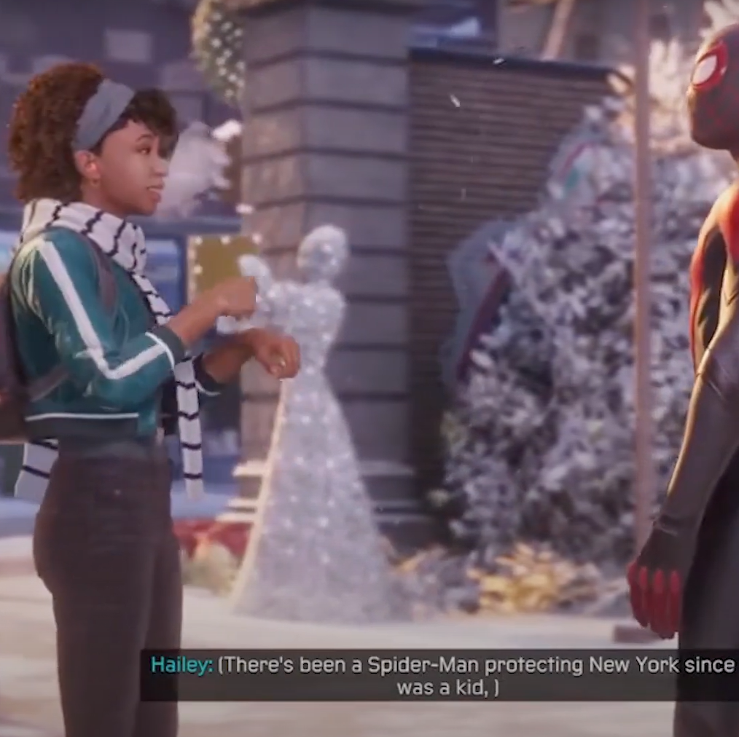
Representation & Inclusion
Spider-Man: Miles Morales
Hellblade Senua’s Sacrafice

Slide 11
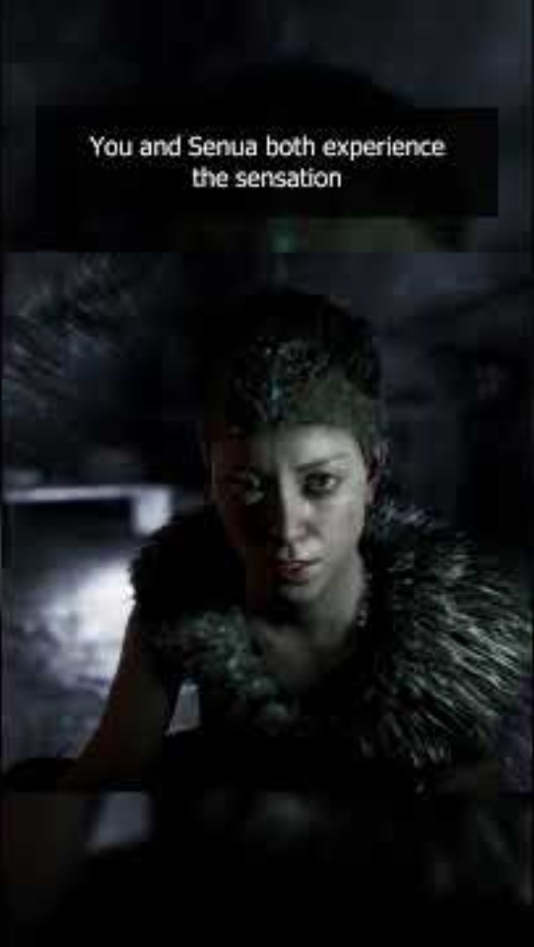
Hellblade Senua’s Sacrifice Example
Notes:
A more in-depth video on how Senua Hellsblade shows Psychosis can be viewed at https://www.youtube.com/watch?v=31PbCTS4Sq4
Hellblade: Senua's Psychosis | Mental Health Feature (youtube.com)

Slide 12

Resources
Find Accessible Games
Can I Play That? (Video Game Focused)
Meeple Like Us (Board & Card Game Focused)
Accessibility - Erissa Duvall (corgidev.com)
Introducing the Xbox Adaptive Controller – YouTube
Video Game Accessibility Playlist | Game Maker’s Toolkit | YouTube
What I learned about Accessibility and Difficulty in Games | Frogwater | YouTube
Totally Blind Gamer Plays The Last of Us Part 1 for the First time \ Accessibility Impressions – YouTube
(219) Meet Spencer Allen – A Gaming for Everyone Story - YouTube

Slide 13


Thank You! / Q&A
https://linktr.ee/corgidev

